Slide 1
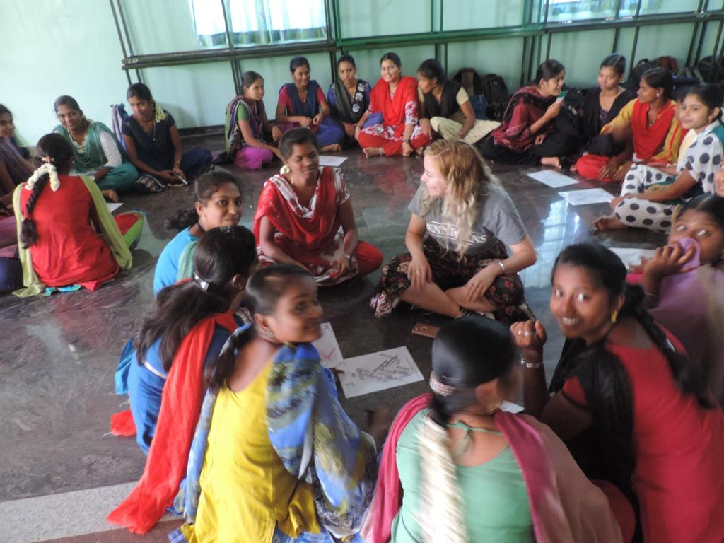
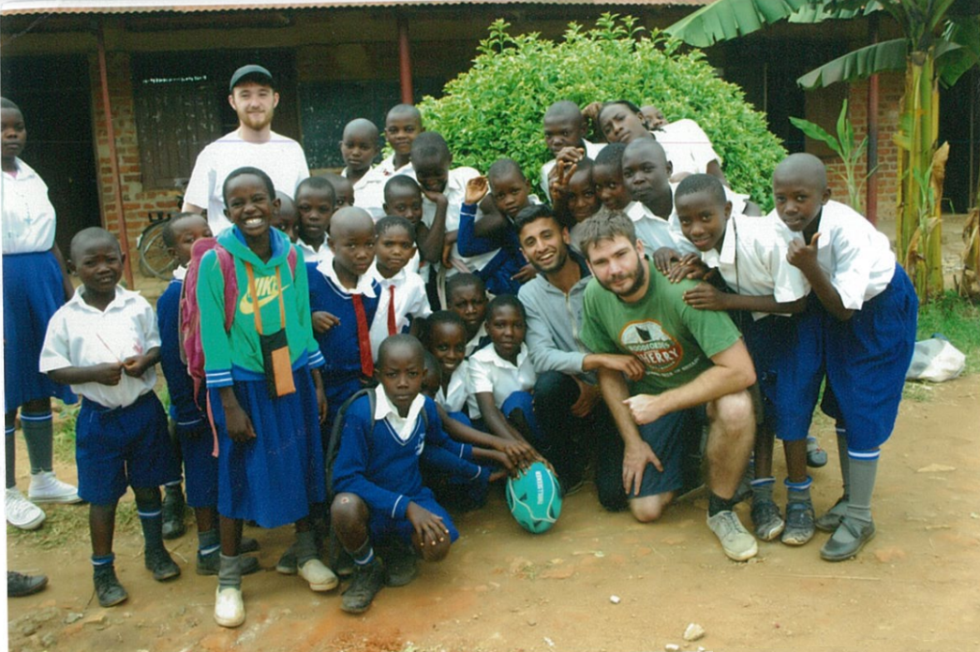
Global Hope 2025
An introduction

Slide 2
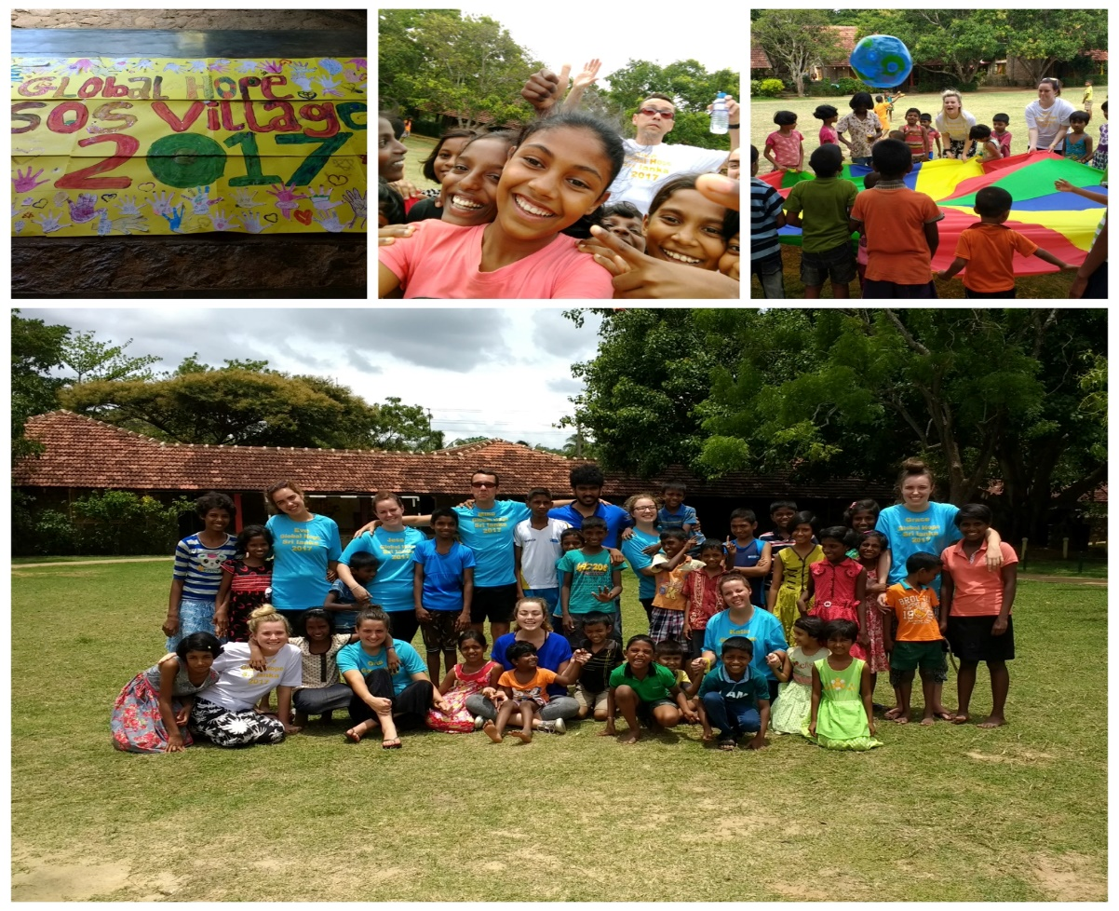
What is Global Hope?
Global Hope is the international volunteering programme run by Liverpool Hope University.
It enables both staff and students to participate in Global Hope partner projects for 2/3 weeks abroad.
As part of the projects, students and staff will volunteer to support the partners based on their identified needs.
We have long standing relationships with multiple project partners.

Slide 3
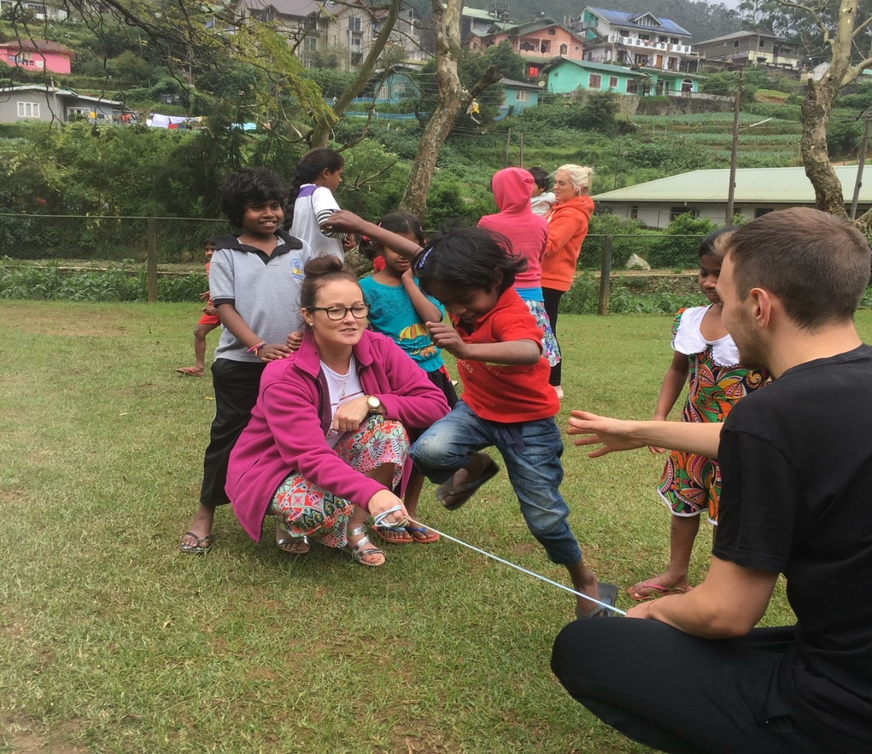
What is Global Hope?
All Global Hope projects are based around millennium development and social justice.
We will work in community projects with disadvantaged children and youth.

Slide 4
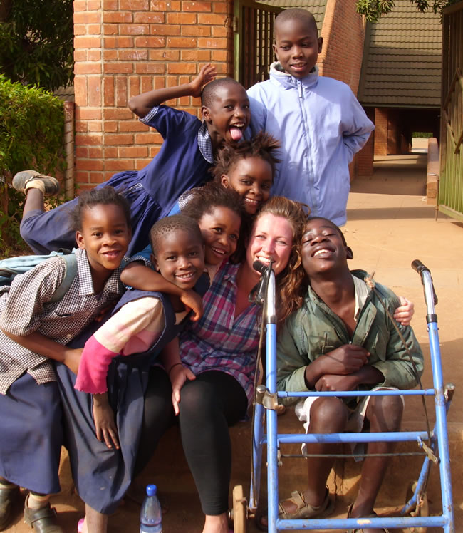
What is it actually like?
Hard work.
In short it is not a holiday.
You will have a life changing experience whilst on your project but you will be required to work whilst there.
Our project will take place in a developing countries, so the facilities are not what you would expect in the western world.
This also applies to the culture. So be prepared to experience things you may not have previously encountered.

Slide 5
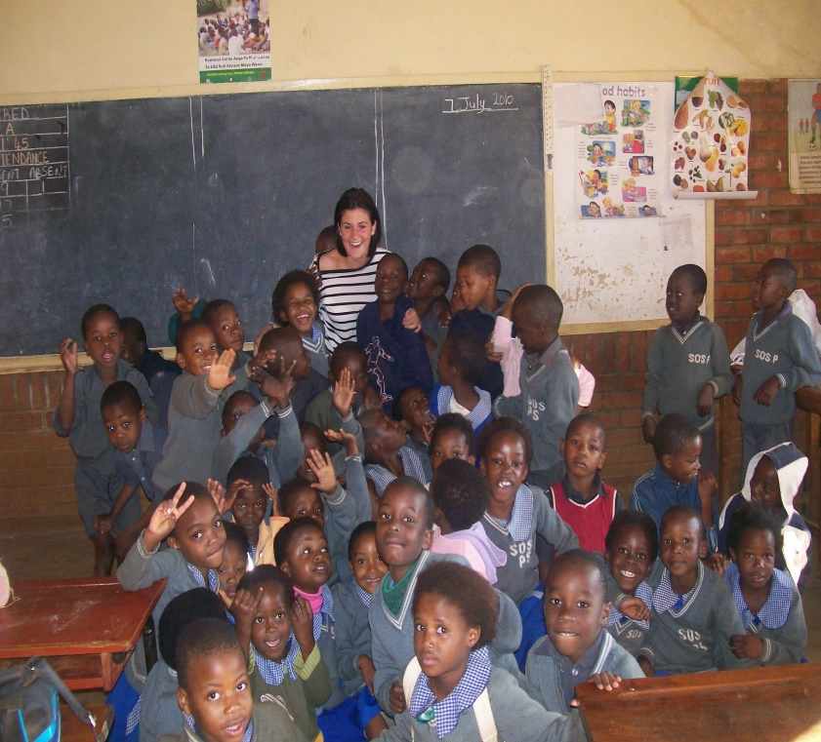
What is it actually like?
There may not always be access to hot running water, WIFI, comfortable beds, air conditioning, western facilities etc.
You may not always enjoy it, but it will be an unforgettable experience.
You may find that changes in climate, food, culture, daily routines etc may get the better of you some days.
So you need to be resilient.

Slide 6
Global Hope 2025
In 2025, Global Hope is running two projects, one overseas and one in the UK
UK
In Summer 2025, volunteers will be engaging in local projects in Liverpool.
Members of the Global Hope Project UK will volunteer in partnership with students from Notre Dame Seishin University, Japan, who we will be hosting on campus.

Slide 7
Global Hope 2025
India
In Spring 2025, volunteers will be going to New Delhi, India.
Members of the Global Hope Project India will volunteer in partnership with Jesus & Mary College, Delhi, on local projects with marginalised communities.
The project will include activities with children and youth around:
- Non - formal education
- youth empowerment
- health promotion
- community development

Slide 8
Duration of Projects - 2025
The India project will run from 14th April to 25th April 2025.
They will travel out to India on Thursday 10th April or Friday 11th April 2025 and will return on the 28th or 29th of April 2025.
Volunteers will get the weekend 26/27th to do sightseeing.
Students will need to be absent from 4 days of classes and will need to get permission from their tutors in advance.

Slide 9
Accommodation & Travel 2025
Volunteers will be staying in a hostel in Delhi for the project.
As mentioned you will also get the last weekend to visit local places of interest.
Flights will be booked with our LHU travel agent.

Slide 10
Global Hope 2025 - contributions
Each Global Hope student will have
given their full financial contribution of £1,500.
They will receive fund raising training.

Slide 11
Global Hope 2025
Staff and students
will work as a team and
meet as project teams at least once a month
to prepare for the project up until their departure.

Slide 12
What do we do?
Our dedicated member of staff works at Hope one day a week and will work with you throughout your time with Global Hope to offer advice and track your financial contribution with you.
They can give you fundraising ideas, show you what has worked in the past, give you banners and collection boxes, etc.
We organise the internal transport to and from the project as well as accommodation whilst there, this is all covered in your £1,500 contribution to Global Hope.

Slide 13
What do we do?
We DO NOT pay for:
your vaccinations
your food whilst you are on the project, there may be opportunities for you to cook for yourself in your accommodation, you may be cooked for by the project partner and you will pay them directly or you may eat in local cafes and restaurants.
for any weekend trips or excursions you choose to take part in, so please factor this in!

Slide 14
Project team
You would also be expected to arrange to meet with your project team multiple times before departure to not only
prepare for the project but to also
get to know each other better!

Slide 15
Requirements
Attend interview
Be enrolled in the Service and Leadership Award (SALA) (Global Hope is a great way to complete SALA)
Work towards the deadlines and complete the financial contribution by the end of October 2024.
Be engaged in your studies, with good academic standing
Meet the criteria for volunteers which will be sent to students after interview or you can find it on the application form.

Slide 16
Requirements
Show active participation in the Liverpool Hope University Community
Attendance of 70% +
Have the ability to commit to all training sessions
Provide feedback to the Global Hope on your return!

Slide 17
Financial Contribution
You are required to contribute £1,500 to take part in a Global Hope project.
The projected final deadline is the end of October 2024.

Slide 18
Financial Contribution
The money that you contribute to Global Hope, helps to fund your:
flights
local transportation
accommodation
visas
the organisation of the project
emergency medical insurance and also
emergency contacts whilst on the project

Slide 19
Financial Contribution
Your contribution can come from anywhere:
- You could do different events
- You can also use some of your part time wages to add to your funds
- You can ask for donations from family and friends
- You can also do fundraising in your teams or with friends and family from back home.
Anything is possible.

Slide 20
What next?
You need to:
Complete the application form you receive by Mid May and hand it back to Global Hope by 31st May 2024. This can be done
- by email (globalhope@hope.ac.uk) or
- by handing in a paper copy to the Global Student and Partnership Centre, 1st Floor, Gateway Building, Hope Park.
Be available for an interview either face to face or via zoom between 10th and 21st June 2024. A mutually convenient time can be arranged.

Slide 21
What next?
If you are successful, you will notified by the end of June.
You will then need to:
Attend all training sessions
Meet with your team at least once a month
Contribute £1,500
Be engaged in your project team

Slide 22
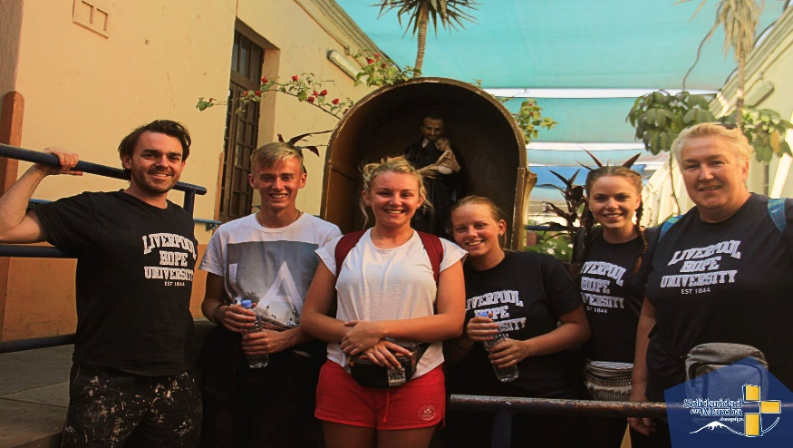
Why should I do it?
It is a very rewarding and self fulfilling experience.
You will get a lot out of going on the project, probably more than what you give to the project.
Even though you only spend a short time there you may find that you do come back as a changed person.
It offers a different perspective on the world and makes you think differently about your everyday life.

Slide 23
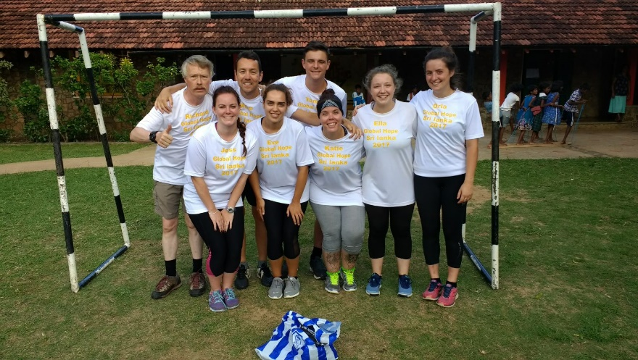
Why should I do it?
You will be able to have an added experience to your undergraduate studies at Liverpool Hope University, so there is a CV boost too!
You will also be well on your way to completing your SALA.
You may not change the world or have a huge lasting impact but you will be making a difference even in a small way to the people you interact with.

Slide 24
Application
If following on from today’s talk, you would like to apply for Global Hope 2025, please email globalhope@hope.ac.uk and we will send you an application form!
Please return it to us by the 31st May 2024.
Please email us if you would like any further information!

Slide 25
Any questions?

Slide 26
Thank you!
Thank you for attending this Intro talk about Global Hope.
If you would like any more information following the session, then again please email globalhope@hope.ac.uk

Slide 27
Acknowledgement!
All graphics are taken from free vector graphics at pixabay.com
All images were shared by previous Global Hope participants
Thank you to those contributing to pixabay and to past Global Hope Participants.

